Slide 1
DESIGN OF AN EMPLOYEE MANAGEMENT SYSTEM.
ENONCHONG HOPE AHONE
ALI-NDI NESINYU TATAH
KWA ADELLA MUNSHA.

Slide 2

OUTLINE
INTRODUCTION.
PROBLEM STATEMENT
FUNTIONAL REQUIREMENTS
NON-FUNCTIONAL REQUIREMENTS.

Slide 3
DESIGN OF AN EMPLOYEE MANAGEMENT SYSTEM
INTRODUCTION.
Brief Description.
This application focus on creating a software solution for businesses and organizations.
The Employee Management System (EMS) will be a software solution that will be designed to streamline and automate various Human Resource processes within a small-scale enterprise.
The system aims to centralize employee data, simplify administrative tasks, and improve overall efficiency in managing personnel-related activities.

Slide 4

.
PROBLEM STATEMENT
The current manual system of managing employees, departments, positions, and project assignments is inefficient and prone to errors. There is a lack of centralized data management, leading to difficulties in tracking employee information, departmental allocations, position assignments, and project participation. This results in inefficiencies in resource allocation, difficulty in decision-making, and reduced productivity. An automated Employee Management System (EMS) is required to streamline processes, improve data accuracy, enhance resource allocation, and optimize employee engagement and project management within the organization.

Slide 5

PROPOSED SYSTEM
Employee Management System.
Objectives.
To consolidate all employee-related information into a centralized database.
To accurately track employee attendance.
To facilitate communication and collaboration.
Manage on boarding n Off boarding ( managing an employee's departure, and integrating new employees).
To empower employees to access and manage their own information
To provide reporting and analytics capabilities for monitoring

Slide 6

Functional requirements.
User Authentication
Employee Profile Management
Onboarding Workflow
Off boarding Workflow
Attendance Tracking
Leave Management
Payroll Integration
Performance Evaluation
Training and Development
Non-Functional Requirement.
Security
Scalability
Performance
Adaptability
Reliability
Compatibility
Integrity
Usability
maintenance

Slide 7
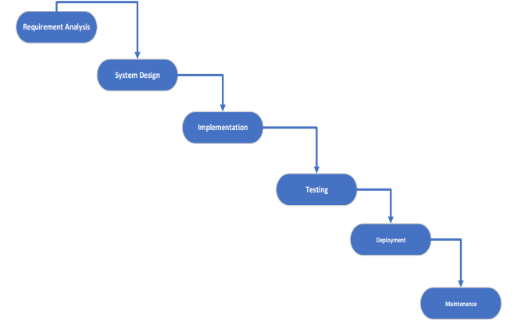
METHODOLOGY: WATERFALL
Waterfall. It is a linear sequential approach to software development with distinct phases.
Reason for choice.
Clear Structure:
Comprehensive Documentation
Predictability
Early Identification of Issues:
Resource Allocation
Customer Involvement

Slide 8

SCOPE OF PROJECT
The scope of a project refers to the extend to which it will be developed. For this EMS it will be simulated with figma and completely analyzed for further development. With its interfaces designed and respective diagrams drawn.

Slide 9
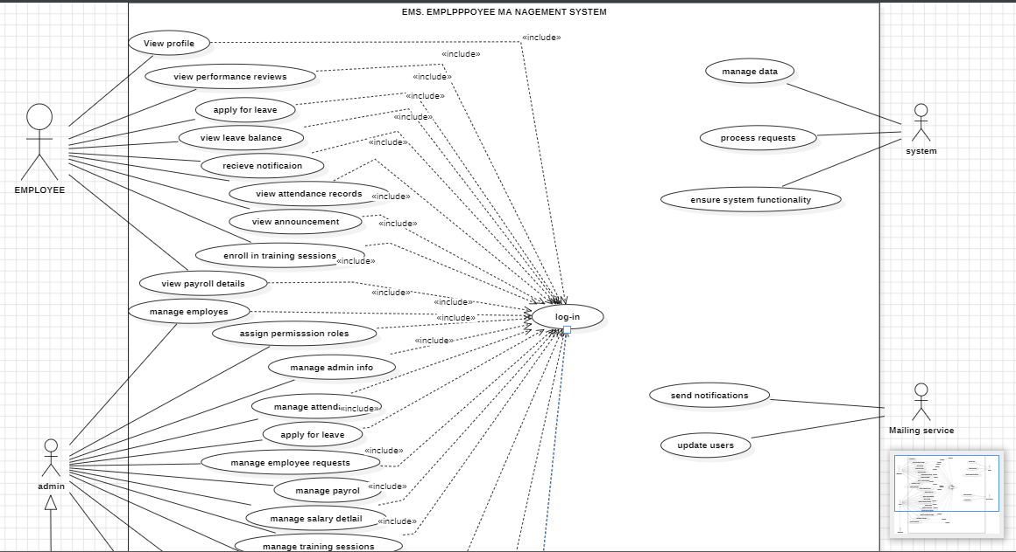
use case

Slide 10
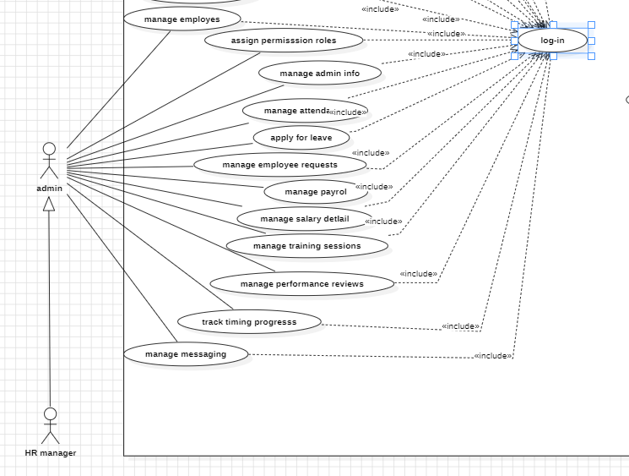

Slide 11
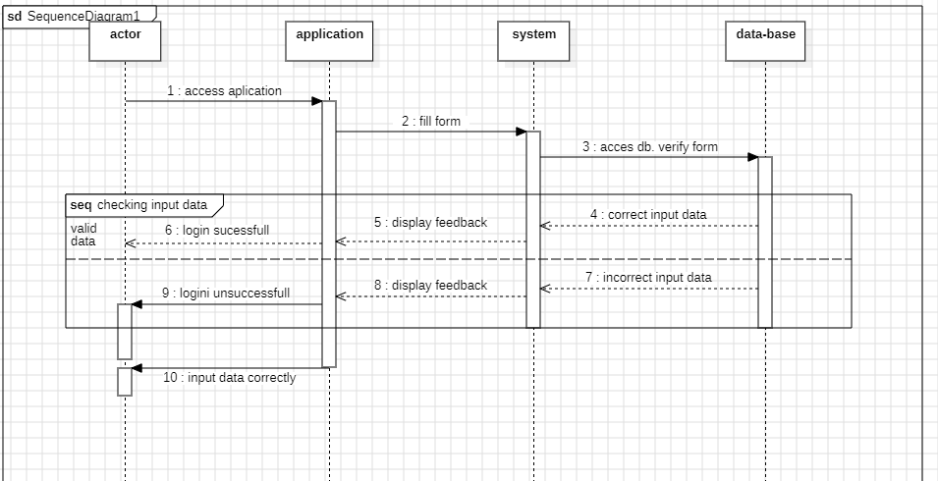
Log-in Sequence diagram

Slide 12
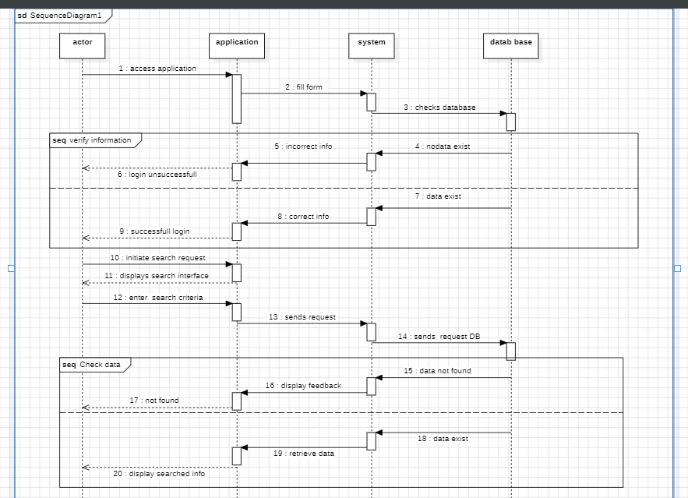
Search info

Slide 13
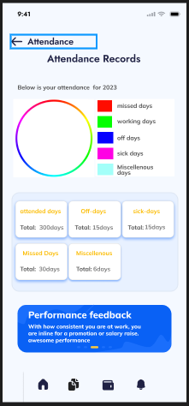
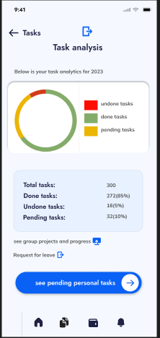
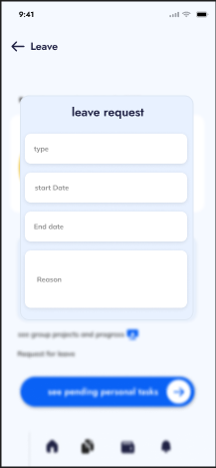
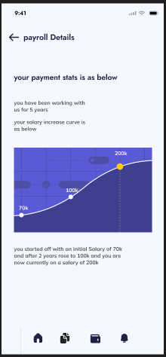
FIGMA DESIGN. Onboarding pages

Slide 14
To conclude.

